Slide 1
Cloud Integration Developer’s Guide to Windows 10

Slide 2
Agenda
Connected Mobile Experiences
Roaming Data
Sharing State using OneDrive
Azure Mobile Apps
Creating an Azure Mobile Apps Service
Offline sync
Push Notifications

Slide 3
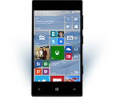
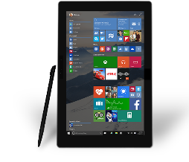
Evolution of Mobile Experiences
Reaching your customers in new and unique ways
Mobile “Devices” led to revolutionary Experiences
“Bring the experience with you”
Came with many constraints (small screen, battery, etc.)
Notes:
The growth of mobile devices has led to a set of revolutionary experiences allowing developers to reach their customers in new and unique ways .
However, up until now, mobility has been attached to “mobile devices” – or devices that you carry on your person like a phone or tablet. You sort of “bring the experience with you”. However, this is a very constrained experience as the screens are small, batteries are limiting, and sharing the experience is typically challenging. How many times have you tried to show everyone in the room a photo? You have to pass around your phone or have everyone look over your shoulder.

Slide 4
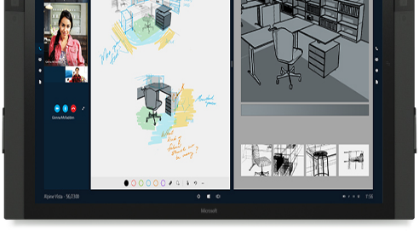
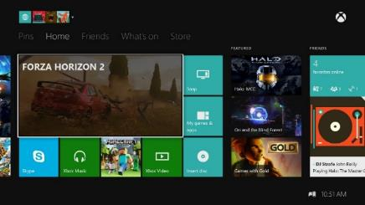
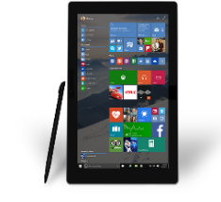


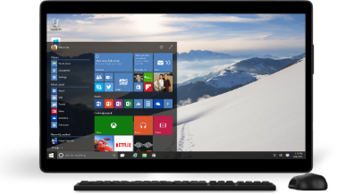
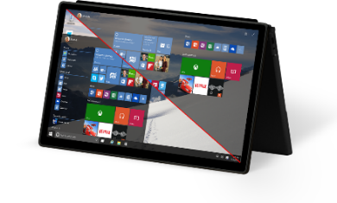
Mobile Experiences - not just mobile devices
The Experience you want on the device you want
User is the center of the experience, not the device.
Available on the right device at the right time
Input model optimized for the experience.
Enabling Mobile Experiences with Universal Apps
User
Notes:
Increasingly, end users are itching to break out of these constraints and have truly mobile EXPERIENCES where they can bring the experience with them to whatever device is most convenient or productive to use.
People want to be at the center of the experience – not their device. If there is a big screen and you want to share an experience with a group – you should be able to bring the experience to that screen.
End users want their experiences available on the right device at the right time – allowing them the simplicity of sharing and collaboration.

Slide 5
Create shared mobile experiences whatever the device
Notes:
With Windows 10 we are blazing a new path forward for MOBILE EXPERIENCES – breaking out of the limited box of just “mobile devices” and all of this is powered with Universal Apps as they can target and run on all devices in the Windows ecosystem.

Slide 6
Roaming Data APIs
Notes:
We have many tools to help you build mobile connected experiences, and the first of those to look at are the UWP Roaming Data APIs

Slide 7
Using the Roaming settings
The RoamingSettings are exposed as a dictionary into which an application can save data
Note: On Windows Desktop, there is a special HighPriority key. This has no effect on Windows Mobile.
Windows.Storage.ApplicationDataContainer roamingSettings =
Windows.Storage.ApplicationData.Current.RoamingSettings;
roamingSettings.Values["userName"] = name.Text; var composite = new Windows.Storage.ApplicationDataCompositeValue(); composite["intVal"] = 1; composite["strVal"] = "string"; roamingSettings.Values["exampleCompositeSetting"] = composite;
Notes:
Data you store in Roaming Settings or in the Roaming Folder is automatically roamed (i.e. synchronized) across a users’ different devices where your app is installed via the cloud.
The Roaming Settings API is a simple string-object dictionary where you can store serializable objects against a string key value. You can also store composite values as shown here that are roamed together.
The key value you use is just an identifier, but if you use the key value “HighPriority”, on Windows 10 Desktop, that value will be roamed immediately. On other device families this value has no special effect and it is roamed at the same priority as other settings.

Slide 8
Reading the Roaming settings
Query the roaming settings by using the key name
Windows.Storage.ApplicationDataContainer roamingSettings =
Windows.Storage.ApplicationData.Current.RoamingSettings;
if (roamingSettings.Values.ContainsKey("userName"))
{
name.Text = roamingSettings.Values["userName"].ToString();
}
Notes:
You read valyes out of the Roaming Settings in exactly the same way as any other Dictionary.

Slide 9
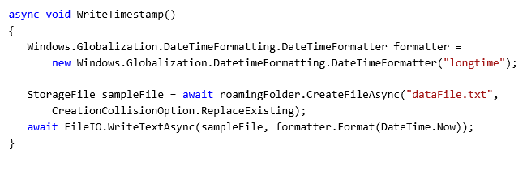
Roaming Folder
Use the roaming app data store to read/write files and folders
Notes:
Alongside Roaming Settings, we have the Roaming Folder.
You use this just as you would a local folder, so you can create directories and files – with the difference that files you store in here are roamed across a users’ devices.

Slide 10
DataChanged notification
The DataChanged event fires when the roaming data has changed
Windows.Storage.ApplicationData.Current.DataChanged += Current_DataChanged;
...
void Current_DataChanged(ApplicationData sender, object args)
{
// Refresh your settings...
}
The event only fires if the application is active
You should still load up all your data when your app starts
Notes:
If an app is currently active, and data inroaming settings or the roaming folder is synchronized to the device at the time the app is running, then your app can be notified through the ApplicationData.DataChanged event.

Slide 11
Debugging apps using Roaming Data
Developers can install an application on multiple unlocked devices
Locking a developer device will trigger the synchronisation
If you have problems:
Make sure that files are closed correctly
Make sure that the devices are running the same version of the application
Notes:
Debugging apps that use roaming data can be tricky!
In general, minimising an app and then putting the device into a low-power sate – such as turning off a Windows Phone so that the lock screen is up when you turn it back on – will cause roaming data to be synchronized to the cloud and then onto other devices.
Make sure you have good network connectivity on all your devices. Note also that running under the debugger may prevent an app from suspending and may inhibit roaming synchronization.

Slide 12
Demo: Roaming Data

Slide 13
Tips on using roaming data
Use roaming folder and roaming settings in the same way as local folder and settings
HighPriority setting is available on Windows Desktop for quick sync, but has no effect on Windows Mobile
Good for app customisation settings, most recent activity, partially completed work
Synchronisation stops if roaming data > 100KB
Bad for synchronising large amounts of data or “instant syncing” scenarios
Last writer wins
Data deleted from cloud if app not used for “a period of time” (~30 days)
Notes:
Sounds great?
Well, yes and no.
Roaming Data comes with some pretty major restrictions that means that while it is great for synchronising preferences and settings around a users’ devices, you shouldn’t use it as your primary application data synchronisation mechanism.
Firstly, synch stops if the volume of roaming data exceeds 100KB. If that happens, your reads and writes to roaming settings or data will still work, except that roaming synchronization stops and the APIs operate exactly the same as local settings and the local folder
There’s no conflict detection, so if you have multiple instances of your app writing to the same files or settings, it will just be last updater wins. And which device that is is dependent on factors such as network conditions.

Slide 14
Do not use Roaming Data as a general purpose data syncing mechanism
Notes:
Roaming Data is a useful tool for synchronizing preferences, settings, MRU (most recently used) lists. But do not use it for your apps primary application data.

Slide 15
Credential Locker securely store and roam user credentials
Notes:
The Credential Locker is a special case of Roaming Settings intended for roaming user credentials

Slide 16
Overview
APIs to store credentials (user name, password) securely
Windows.Security.Credentials
Benefits:
Secure storage
Credential isolation
Roaming
Notes:
The Credential Locker works in a similar way to Roaming Settings, except it stores user credential objects and the data is encrypted.
It allows scenarios such as querying a user for their credentials the first time they run your app. Then when they install your app onto another device and run it, the app logs onto your cloud service silently without querying for credentials again, as it has retrieved them from the credential locker.

Slide 17

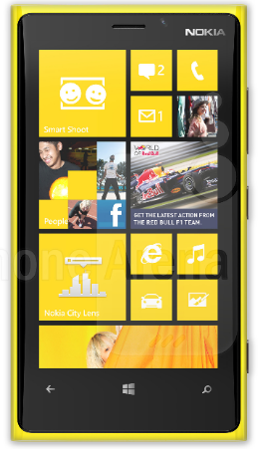
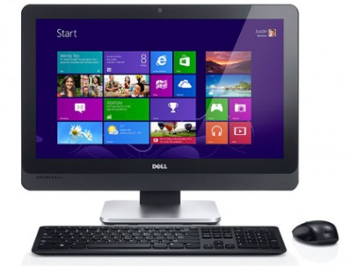
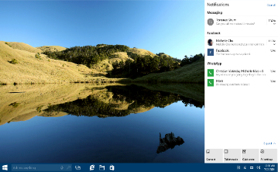


Roaming
Credentials roam across trusted devices
Uses public or business cloud according to primary user identity
MSA
App
App
AAD
Notes:
Credentials stored in Credential Locker roam via the public cloud for apps installed from the public Windows Store, secured by a users’ MSA (Microsoft Account) identity.
For apps installed from the Business Store, the identity used is the users’ AAD (Azure ctive Directory) identity and data is roamed via the commercial cloud.
From the app developers point of view, usage of the APIs is identical in either case.

Slide 18
Credential Locker sample
void SaveCredential(string username, string password) { PasswordVault vault = new PasswordVault(); PasswordCredential cred = new PasswordCredential("MyAppResource", username, password); vault.Add(cred); } IReadOnlyList<PasswordCredential> RetrieveCredential(string resource) { PasswordVault vault = new PasswordVault(); return vault.FindAllByResource(resource); }
Notes:
To store credentials in Credential Locker, you create PasswordCredential objects and save them in the PasswordVault.
You store them identified with a string key value – use this key to locate credentials in the vault and read them out.

Slide 19
Sharing State using OneDrive
Notes:
When considering what kind of cloud storage to use for sharing your app data across multiple devices, consider using OneDrive. OneDrive is free online storage that comes with your Microsoft account. Save your files there and you'll be able to get to them from any PC, tablet or phone.

Slide 20
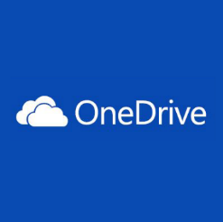
OneDrive Cloud Storage
OneDrive
Accessible cloud storage for personal documents, photos, and files that can be accessed from anywhere.
Best for user owned content.
OneDrive for Business
Secure enterprise grade storage for business documents and files.
Best for business / enterprise owned content.
Depending on your app targeting both is appropriate.
Notes:
When a user installs apps from the public Windows Store, they authenticate using their Microsoft Account credentials. This comes with free OneDrive cloud storage which is primarily intended to be used by the user for storing their personal files and photos.
For Windows 10 machines that are setup for business or education use, users authenticate against Azure Active Directory and install apps from the Business Store. Services such as Office 365 come with OneDrive for Business.
For the app developer, you have the possibility of storing app data files in OneDrive or OneDrive for Business. Be aware though, that such files are visible to the user and could be deleted by them at any time. If you enable this functionality, it is advisable for your app to provide a dialog for the user to agree to OneDrive storage being used so that they are aware.

Slide 21
OneDrive Integration choices
Two pathways to light up OneDrive<->app integration
Pickers and savers for quick integrations.
Quickly open files from OneDrive and save files back.
Supported for JavaScript, iOS, Android, and Windows Universal apps.
OneDrive API for deeper / robust integrations.
Rich web API that enables all integrations with OneDrive.
First party applications built on this.
More information: //BUILD/ session 3-734
New OneDrive APIs for Developing Against OneDrive AND OneDrive for Business
http://channel9.msdn.com/Events/Build/2015/3-734
Notes:
There are a number of ways for an app to integrate with OneDrive storage.
File Pickers and Savers APIs are available for Windows, iOS, Android and JavaScript. For deeper integrations, the OneDrive REST web API is available to enable integrations with OneDrive.

Slide 22
Demo: OneDrive File Access

Slide 23
Azure App Service Mobile Apps
Notes:
OneDrive offers file based cloud storage. However, for a fully functional cloud backend for your mobile app, you should consider using Microsoft Azure, and in particular Azure App Service Mobile Apps.

Slide 24

App Service: one integrated offering
Web Apps
Mobile Apps
Web apps that scale with your business
Build Mobile apps for any device
LOGIC Apps
API Apps
Automate business process across SaaS and on-premises
Easily build and consume APIs in the cloud
Notes:
App service – What is it?
It is an integrated offering that gives you four components.
The first of these is Web Apps, which is basically Azure Websites rebranded – with some new features of course. The reason for this rebranding is that Azure Websites are a great way of hosting code, not just websites. And in fact under the wrappers, Mobile Apps and API Apps are built on top of Azure Web Apps.
The cool thing about App Service is that all these components can share all the features of Web Apps, because the hosting environment is actually shared.
[Click] So Mobile Apps you can think of as Mobile Services platformed onto Azure App Service.
Logic apps is about orchestrating multiple pieces of your system together, so business processes. Example is a customer sends an email and a LOGIC app posts the details into your CRM.
API apps are kind of the glue that connects everything together. You can build an API app that is custom, or you can use one of the connectors that we have in the gallery. So for example, there is SalesForce and there’s SQL and a bunch of enterprise connectors. There’s also social network connectors such as Twilio and things like that.

Slide 25
App Service
Create web and mobile experiences that share data access and business logic
Automate business processes with logic apps
Build custom APIs or consume connectors from Marketplace
One common billing model for all of your App Services
Use a common Gateway to authenticate
Notes:
What this means for Mobile Services customers is that you have more control.
You have one billing model for all your App Services. You can manage resources so that your busy website gets more resources, while your mobile app clients which use offline sync so are not very chatty , they get less.
Another important aspect of App Services is that you have a single Gateway, which is technically part of API Apps, which is used by all the components of App Services and provides a single point that handles authentication.

Slide 26
Demo: Creating an Azure Mobile App

Slide 27
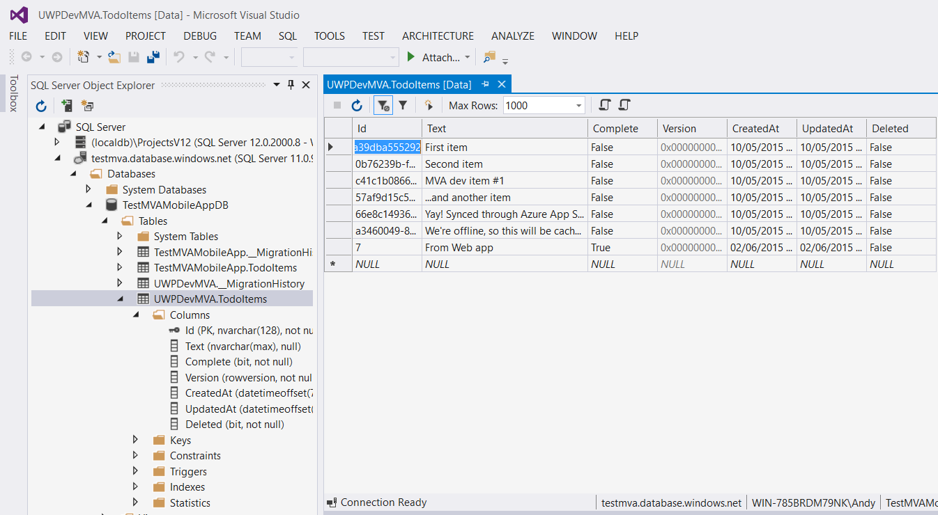
Mobile Apps Dynamic Schema
Very easy to configure backend data tables!
Create new table in backend store
Define data objects and a Database Initializer function
Table auto-configured on first client request with columns, plus sync tracking columns
During dev, schema changes cause table to be dropped and re-created
Or use Entity Framework datamigrations
Notes:
One of the great features of Azure App Service Mobile Apps is how easy it is to configure the backend database during development.
You simply define your classes for your data objects, a Controller class for each data item and code a database initializer function in your WebApiConfig class. On the first request from a client, the tables in your backend database are automatically configured with columns to match the data item, with the addition of offline sync tracking columns.
During development, if you change your data object columns, by default, the table is automatically dropped and then re-created. If you do not want to lose your data, you can use Entity Framework data migrations to migrate your data to the new table layout.

Slide 28
Azure Mobile Offline data sync
Notes:
One of the best features of Azure App Service Mobile Apps is its support for offline data sync

Slide 29
The best mobile apps handle network interruptions gracefully
Notes:
Mobile apps operate on mobile devices, and uninterrupted network connectivity cannot be guaranteed.
The best mobile apps can handle periods of offline operation and still offer some level of functionality to the user when offline.

Slide 30
Adding offline sync to an app is usually hard. With Azure Mobile App, it’s easy.
Notes:
Data synchronization from a client to a backend service when connectivity is restored is a notoriously difficult thing to achieve. Timestamping of changes, pushing updates to the server and pulling the consolidated updates back to the client, while handling update conflicts is difficult to achieve.
With Azure Mobile App, this is easy!

Slide 31
Why use mobile offline sync?
Improve app responsiveness by caching server data locally on the device
Make apps resilient against intermittent network connectivity
Allow end-users to create and modify data even when there is no network access
Sync data across multiple devices
Detect and handle conflicts when the same record is modified by more than one client
Notes:
Azure Mobile App offline sync support uses SQLite by default on the client. Data is pulled from the backend service and cached locally on the client in SQLite so that lookups can be performed locally and can still operate against cached data when offline.
An app on an offline device can still make changes and additions to application data even when offline, working against the local data cache. When connectivity is restored, the app can push local changes back up to the server.

Slide 32
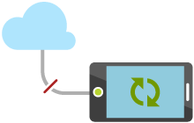
How it works
Access data from Mobile Services tables even when app is offline
Keep a local queue of Create, Update, Delete operations and synchronize with server when app is back online
Detect conflicts when same item is changed both locally and on server
Use soft delete to remove deleted records from client data stores
Can use push notifications to trigger client sync
Notes:
All changes are tracked, so that when connectivity is restored, local changes can be pushed back up to the server and any changes applied server-side by other clients can be pulled back to get the client back in sync.
Allowing offline data changes introduces the possibility of two clients updating the same data object. Azure Mobile Apps can detect change conflicts and allows your application code to resolve them.

Slide 33
Demo: Azure Mobile App Offline Sync

Slide 34







Handle client sync conflicts
Client
Conflict resolution
Server
Conflict resolution
Notes:
Azure App Service Mobile Apps uses a technique called Optimistic Concurrency to detect update conflicts. This is a fancy name for version stamping – when changes from a client get pushed up to the server, the server can check whether the version the client has changed is the same as the version it currently holds on the backend, and if they are the same the update is allowed.
If the server-side version is later than the version the client has updated, then another client has updated the same record in the meantime, and a conflict has occurred.
You can write code to resolve update conflicts either on the server-side in your backend service code, or you can push an error report back to the client and have code on the client determine how to resolve the conflict – perhaps by allowing the server-side changes to prevail, and display a warning message to the user.

Slide 35


Detect Conflicts with Optimistic Concurrency
Server
Device 1
Device 2
Create
▲, 1
▲, 1
▲, 1
▲, 1
Fetch
▲, 1
Update
▲, 1
■, 2
▲, 1
▲, 1
■, 2
Update
✘
●, 2
▲, 1
■, 2
■, 2
Notes:
This shows at a simple level how optimistic concurrency works:
<Click> Device 1 creates a data item, which is V1 and is a triangle
<Click> It pushes this addition to the server.
<Click> At this point, client 1 and the server both hold version 1
<Click> Device 2 now syncs with the service, so it pulls down V1 of our data object
<Click> So now both devices and the server hold the same version of our data object.
<Click> Device 2 now changes our data object to a square, and this is version 2 of our data object
<Click> It pushes its updates back to the server
<Click> So at this point, the server and Device 2 have V2 of our data object, but Device 1 still has V1 since it hasn’t synchronized with the service yet.
<Click> Device 1 also makes a change to the data object – but does so before synchronizing because it is offline. So it changes the data object to a circle and increments the version number to V2 as well
<Click> When it tries to push the update to the server, the server code detects that the ‘Version 2’ that device 1 is tryong to push up is not the same as the ‘Version 2’ that it already has in the server-side database, so it detects that an udate conflict has occurred.
At this point, code in your application, either on the server or on the client must take action to either overwrite the server copy of the data, or to rollback the change that Device 1 is trying to make, in order to get all clients and the server synchronized.

Slide 36
Summary: Azure Mobile App offline sync
Supports both “primarily online” and “occasionally connected” scenarios
Explicit push and pull leaves control to the developer
Works with a variety of server data stores
SQL, Azure Tables, Mongo, Dynamics CRM, Salesforce, etc.
Cross-platform client SDKs
Windows Universal, Xamarin, iOS, Android
Flexible and powerful
Supports custom local storage layers
Detect and handle conflicts on server or client
Notes:
Support for offline sync in Azure App Service Mobile App is easy to implement and a powerful solution.
By default, it works with SQL Azure for your backend data store, but you can also link it to an on premises SQL Server, or you can use other cloud storage such as SQL Azure Tables, Mongo DB and others.
Azure App Service is not a Windows client only solution! It supports iOS, Android and Xamarin clients as well.

Slide 37
Adding push notifications
Notes:
Another attractive feature of Azure App Service Mobile Apps is how easy it is to implement cross-platform push notifications from your backend code.

Slide 38

Push Notifications 101
Register device handle at app launch
Client app retrieves handle from Platform Notification Service (PNS)
Client app sends handle to your custom backend
Send Notification
Your backend connects to PNS and requests push Your code has to manage scale Your code has to map between logical users and device handles
PNS pushes notification to device
Maintain backend device handles
Your code must delete expired handles when PNS rejects them
Your code must map between logical users and device handles
1
4
Client app
2
3
Platform
Notification
Service
5
App back-end
6
Notes:
All mobile OS’s – Windows, iOS, Android – support cloud-based notifications. Named differently of course, but they all operate in broadly the same way:
The client app registers with its push notifications infrastructure for a push channel handle
It must then send its unique push channel handle to some kind of cloud service that you build to support your app. That cloud service must maintain a register of all the channel handles from all the clients of the app, including pruning out those for expired clients
When the app backend system has a push notification to send to one or more clients, it calls the platform notifications services passing the channel handle. The platform notifications services take care of delivering the notification(s) to the client devices.

Slide 39


Azure Notification Hubs
Register device handle at app launch
Client app retrieves handle from Platform Notification Service
Client sends handle to your backend Backend registers with Notification Hub using tags to represent logical users and groups
Send Notification
Backend sends request to Notification Hub using a tag Notification Hub manages scale Notification Hub maps logical users/groups to device handles
Notification Hub delivers notifications to matching devices
Maintain backend device handles
Notification Hub deletes expired handles when PNS rejects
Notification Hub maintains mapping between logical users/groups and device handles
1
4
Client app
PNS
4
5
2
6
2
3
App back-end
Notification
Hub
Notes:
Any app that implements push notifications from the cloud can benefit by using Azure Notification Hubs. Azure App Services Mobile apps uses Notification Hubs.
Notifications Hubs is a service that abstracts away the platform differences of sending notifications to Windows, iOS or Android clients. It provides an easy to use REST API for sending notifications.
It also automatically manages the list of client channel handles and maintains that list, freeing your own cloud services from having to perform that task.

Slide 40
Demo: Push Notifications

Slide 41
Try it now
Try Azure Mobile App for free!
No credit card required!
Go to aka.ms/TryMobileApp
Learn more
Go to aka.ms/AppServiceMobile
Tweet @azuremobile
Notes:
You can try Azure App Service Mobile App for free, and learn more at http://aka.ms/AppServiceMobile

Slide 42
Review
Connected Mobile Experiences
Roaming Data
Sharing State using OneDrive
Azure Mobile Apps
Creating an Azure Mobile Apps Service
Offline sync
Push Notifications

